Slide 1
Apache Atlas: Data Governance Part 2
HDP 2.3
Q3’ 2015

Slide 2
Disclaimer
This document may contain product features and technology directions that are under development, may be under development in the future or may ultimately not be developed.
Project capabilities are based on information that is publicly available within the Apache Software Foundation project websites ("Apache"). Progress of the project capabilities can be tracked from inception to release through Apache, however, technical feasibility, market demand, user feedback and the overarching Apache Software Foundation community development process can all effect timing and final delivery.
This document’s description of these features and technology directions does not represent a contractual commitment, promise or obligation from Hortonworks to deliver these features in any generally available product.
Product features and technology directions are subject to change, and must not be included in contracts, purchase orders, or sales agreements of any kind.
Since this document contains an outline of general product development plans, customers should not rely upon it when making purchasing decisions.

Slide 3



Shivaji Dutta
Senior Partner
Solutions Engineering
Seetharam Venkatesh
Lead Architect
Atlas Development
Andrew Ahn
Director, Governance
Product Management

Slide 4
Atlas
Overview
Governance Overview
HDP 2.3 Features
Ingestion &
Architecture
Trucking POC
Custom / Native connectors
Architecture
Roadmap
2015
Additional Atlas components
Atlas-Ranger integration
Competitive Summary
Notes:
We have a lot to cover, want to apologize in advance

Slide 5
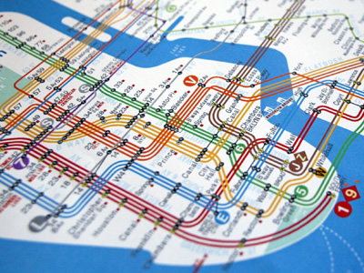
What is Data Governance ?

Slide 6
What is Data Governance ?
Data Governance = Control

Slide 7
What is Data Governance ?
Data Governance = Control
Data governance is used by organizations to exercise control over processes and methods used by their data stewards and data custodians to meet internal and external tests or requirements.

Slide 8
Enterprise Data Governance Goals
GOALS: Provide a common approach to data governance across all systems and data within the organization
Transparent Governance standards & protocols must be clearly defined and available to all
Reproducible Recreate the relevant data landscape at a point in time
Auditable All relevant events and assets but be traceable with appropriate historical lineage
Consistent Compliance practices must be consistent
Visualization
& Dashboards
Business Analytics
Governance Framework
ETL/DQ
BPM
MDM
ERP
ARCHIVE
CRM
SCM
Notes:
A data governance framework in any organization comprises a combination of people, process and technology that are in place to establish decision rights and accountabilities for information. A governance policy defines who can take what actions with what information, and when, under what circumstances, using what methods.
The technology goals for a data governance framework are to provide a platform for a common approach across all systems and data within the organization, Explicitly they need to be:
- Transparent: Governance standards & protocols must be clearly defined and available to all
- Reproducible: Recreate the relevant data landscape at a point in time
- Auditable: All relevant events and assets but be traceable with appropriate historical lineage
- Consistent: Compliance practices must be consistent

Slide 9

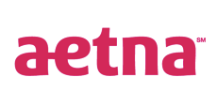


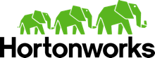


DGI becomes Apache Atlas
Visualization
& Dashboards
Data Governance Initiative
TWO Requirements
Hadoop must snap in to the existing frameworks and be a good citizen
Hadoop must also provide governance within its own stack of technologies
Business Analytics
Apache Pig
Apache Hive
Apache HBase
Apache Accumulo
Apache Solr
Apache Spark
Apache Storm
Common Governance Framework
ETL/DQ
BPM
MDM
1
°
°
°
°
°
°
°
°
°
°
°
°
°
°
°
°
°
°
°
°
°
ERP
ARCHIVE
A group of companies dedicated to meeting these requirements in the open
CRM
SCM
Major Bank
Notes:
Consistent with our approach, Hortonworks recently led the development Data Governance Initiative which brings together industry experts from some of the largest enterprise, traditional vendors and Hadoop experts to address governance within Hadoop.
The members have already defined a comprehensive solution for data governance in Hadoop that will provide the base functions of metadata services, deep audit store and an advanced policy rules engine, but also and more importantly, the solution will interoperate with and extend existing third-party data governance and management tools by shedding light on the access of data within Hadoop.
This approach allows organizations to apply comprehensive governance policy across their data.
In order to provide these functions for Hadoop, much work will need to be accomplished throughout all of the Hadoop projects. The initiative is unique in that it is not a spot solution, but will build on top of existing projects such as Apache Falcon for data lifecycle management and Apache Ranger for global security policies.
The founding members of this initiative include, Aetna, Target, Merck, SAS and Hortonworks and many more are lined up to contribute. This is a broad community based initiative set to deliver the right features for the right requirements and is perfectly representative of the Hortonworks open community approach.

Slide 10


Core Capabilities of HDP 2.3
DATA ACCESS
GOVERNANCE & INTEGRATION
SECURITY
OPERATIONS
Hortonworks Data Platform 2.3
DATA MANAGEMENT
Data Lifecycle & Governance
Falcon
Atlas
Batch
MapReduce
Script
Pig
SQL
Hive
NoSQL
HBase
Accumulo
Phoenix
Stream
Storm
Search
Solr
In-memory
Spark
Others
ISV Engines
Administration
Authentication
Authorization
Audit
Data Protection
Ranger
Knox
Atlas
HDFS DARE
Provision, Manage, & Monitor
Ambari
Cloudbreak
Zookeeper
Tez
Tez
Tez
Slider
Slider
YARN : Data Operating System
Data Workflow
Sqoop
Flume
Kafka
NFS
WebHDFS
HDFS Hadoop Distributed File System
1
°
°
°
°
°
°
°
°
°
°
Scheduling
Oozie
°
°
°
°
°
°
°
°
°
°
N
Deployment Choice
Linux
Windows
On-Premise
Cloud

Slide 11
Core Capabilities of HDP 2.3
DATA ACCESS
GOVERNANCE & INTEGRATION
SECURITY
OPERATIONS
Hortonworks Data Platform 2.3
DATA MANAGEMENT
Data Lifecycle & Governance
Falcon
Atlas
Batch
MapReduce
Script
Pig
SQL
Hive
NoSQL
HBase
Accumulo
Phoenix
Stream
Storm
Search
Solr
In-memory
Spark
Others
ISV Engines
Administration
Authentication
Authorization
Audit
Data Protection
Ranger
Knox
Atlas
HDFS DARE
Provision, Manage, & Monitor
Ambari
Cloudbreak
Zookeeper
Tez
Tez
Tez
Slider
Slider
YARN : Data Operating System
Data Workflow
Sqoop
Flume
Kafka
NFS
WebHDFS
HDFS Hadoop Distributed File System
1
°
°
°
°
°
°
°
°
°
°
Scheduling
Oozie
°
°
°
°
°
°
°
°
°
°
N
Deployment Choice
Linux
Windows
On-Premise
Cloud

Slide 12
Apache Atlas Overview
We Do Hadoop

Slide 13
What is Apache Atlas ?
Hive
Ranger
Falcon
Kafka
Storm
Apache Atlas
Notes:
One of the most important and challenging goals is consistency and when we inspect implementation of data governance for a Hadoop implementation this consistency seems almost impossible.
While there are constructs within the various Hadoop related projects to aid governance, there is no single, consistent approach to implementation/architecture of this important framework. Disparate tools, such as HCatalog, Ranger and Falcon provide pieces of the overall solution, but are not holistic across the stack in approach.
Further, with Hadoop gaining traction in the enterprise, it has only recently been asked to integrate with existing frameworks such as operations, security and now governance. It is now a foundational concern.

Slide 14
What is Apache Atlas ?
Metadata
Hive
Ranger
Falcon
Kafka
Storm
Apache Atlas
Notes:
One of the most important and challenging goals is consistency and when we inspect implementation of data governance for a Hadoop implementation this consistency seems almost impossible.
While there are constructs within the various Hadoop related projects to aid governance, there is no single, consistent approach to implementation/architecture of this important framework. Disparate tools, such as HCatalog, Ranger and Falcon provide pieces of the overall solution, but are not holistic across the stack in approach.
Further, with Hadoop gaining traction in the enterprise, it has only recently been asked to integrate with existing frameworks such as operations, security and now governance. It is now a foundational concern.

Slide 15
Apache Atlas Vision 2015
Metadata Services
Business Taxonomy - classification
Operational Data – Model for Hive: DB, Tables, Col,
Centralized location for all metadata inside HDP
Single Interface point for Metadata Exchange with platforms outside of HDP.
Search & Prescriptive Lineage – Model and Audit
Hive
Ranger
Falcon
Kafka
Storm
Apache Atlas
Notes:
One of the most important and challenging goals is consistency and when we inspect implementation of data governance for a Hadoop implementation this consistency seems almost impossible.
While there are constructs within the various Hadoop related roojects to aid governance, there is no single, consistent approach to implementation/architecture of this important framework. Disparate tools, such as HCatalog, Ranger and Falcon provide pieces of the overall solution, but are not holistic across the stack in approach.
Further, with Hadoop gaining traction in the enterprise, it has only recently been asked to integrate with existing frameworks such as operations, security and now governance. It is now a foundational concern.

Slide 16
Overlap with Falcon ?
Atlas provides: Metadata
Business Classification (taxonomy): Products> Vehicles> Trucks
Hierarchy with Inheritance of attribute to child objects: Sensitive “PII” tag of department HR will be inherited by group HR>Benefits
Repository for any HDP or external reporting via REST API’s
Does not orchestrate any action in HDP
Comprehensive….but not instance-based.
Falcon provides: Life Cycle
Excels with data handling – movement, archival, eviction
Definition, monitoring and tracing of Falcon pipeline entities and instances only.
Can be used to label feeds, processes, & clusters but not based on any defined taxonomy (free-form tagging)
Atlas provides taxonomy to replace labels in Falcon
Hive
Ranger
Falcon
Kafka
Storm
Apache Atlas
Notes:
Apache Atlas = low level service like yarn. It will be common to the whole HDP platform, providing core metadata services and enriching the whole HDP stack. We start with Hive in HDP 2.3 and will extend to Ranger and Falcon in M10 and continue with Kafka and Storm by the end of 2015.
Yellow + Atlas = goverance features.

Slide 17
Apache Atlas Overview
RESTful interface - HDP 2.3
Extensible enterprise classification of data assets, relationships and policies organized in a meaningful way -- aligned to business organization.
Supports exploration via user interface
Supports extensibility via API and CLI exposure
Healthcare
HIPAA
HL7
Financial
SOX
Dodd-Frank
Custom
CWM
Retail
PCI
PII
Other
REST API
Services
Apache Atlas
Search
Lineage
Exchange
Knowledge Store
Policy Engine
Taxonomies
Policy Rules
Type-System
Models
Data Lifecycle Management
Audit Store
Security
Notes:
CWM – common warehouse metamodel.
Default way to build out the model scaffolding – Meta integration uses this to OE to informatica.
** Can run on any posix system. In hadoop or outside. On premise or in the cloud. Flexible.

Slide 18
Apache Atlas Overview
Search & Lineage (Browse) – HDP 2.3
Pre-defined navigation paths to explore the data classification and audit information
Text-based search features locates relevant data and audit event across Data Lake quickly and accurately
Browse visualization of data set lineage allowing users to drill-down into operational, security, and provenance related information
SQL like DSL – domain specific language
Healthcare
HIPAA
HL7
Financial
SOX
Dodd-Frank
Custom
CWM
Retail
PCI
PII
Other
REST API
Services
Apache Atlas
Search
Lineage
Exchange
Knowledge Store
Policy Engine
Taxonomies
Policy Rules
Type-System
Models
Data Lifecycle Management
Audit Store
Security
Notes:
CWM – common warehouse metamodel.
Default way to build out the model scaffolding – Meta integration uses this to OE to informatica.
** Can run on any posix system. In hadoop or outside. On premise or in the cloud. Flexible.

Slide 19
Apache Atlas Overview
Taxonomy available – HDP 2.3
Knowledge store categorized with appropriate business-oriented taxonomy
Data sets & objects
Tables / Columns
Logical context
Source, destination
Support exchange of metadata between foundation components and third-party applications/governance tools
Leverages existing Hadoop metastores
Healthcare
HIPAA
HL7
Financial
SOX
Dodd-Frank
Custom
CWM
Retail
PCI
PII
Other
REST API
Services
Apache Atlas
Search
Lineage
Exchange
Knowledge Store
Policy Engine
Taxonomies
Policy Rules
Type-System
Models
Data Lifecycle Management
Audit Store
Security
Notes:
CWM – common warehouse metamodel.
Default way to build out the model scaffolding – Meta integration uses this to OE to informatica.

Slide 20
Business Taxonomy Example : Trucking Tags
Sensitivity
EMP_PII
Financial
Violation
Search with inheritance:
Sensitivity = All
Financial = Financial, Violation
Violation = Violation

Slide 21
Traits (Tag) to Entity Mapping
Trait (Tag) | Entity
EMP_PII: Personally Identifiable Information | DRIVERS
Financial: Revenue information | TIMESHEET, bad_drivers
Rule_Violations: Civil Penalties | bad_drivers

Slide 22
What is available now versus later ?
Metadata Services – HDP 2.3
Business Taxonomy - classification
Operational Data – Model for Hive: DB, Tables, Col,
Centralized location for all metadata inside HDP
Single Interface point for Metadata Exchange with platforms outside of HDP.
Metadata will enrich every component
Hive – Complete lineage, every SQL tracked – HDP 2.3
Ranger – Tag or Attribute security ABAC – XXX
Falcon – Business Taxonomy – XXX
Now
2.3
Q3
Q4
Hive
Ranger
Falcon
Kafka
Storm
Apache Atlas
Now
Notes:
One of the most important and challenging goals is consistency and when we inspect implementation of data governance for a Hadoop implementation this consistency seems almost impossible.
While there are constructs within the various Hadoop related projects to aid governance, there is no single, consistent approach to implementation/architecture of this important framework. Disparate tools, such as HCatalog, Ranger and Falcon provide pieces of the overall solution, but are not holistic across the stack in approach.
Further, with Hadoop gaining traction in the enterprise, it has only recently been asked to integrate with existing frameworks such as operations, security and now governance. It is now a foundational concern.

Slide 23
Key Concepts
Business Taxonomy (Classification) – The practice and science of classification of things or concepts, including the principles that underlie such classification. The business logical organization model includes hierarchical & inheritance.
Data Lineage (Provenance) – Data lineage is defined as a data life cycle that includes the data's origins and where it moves over time.” It describes what happens to data as it goes through diverse processes. It helps provide visibility into the analytics pipeline and simplifies tracing errors back to their sources.
Tags: Traits vs Label – Falcon has free form labels. Atlas has Traits (aka Tags) that are hierarchical and prevent duplication

Slide 24
Apache Atlas Screens

Slide 25
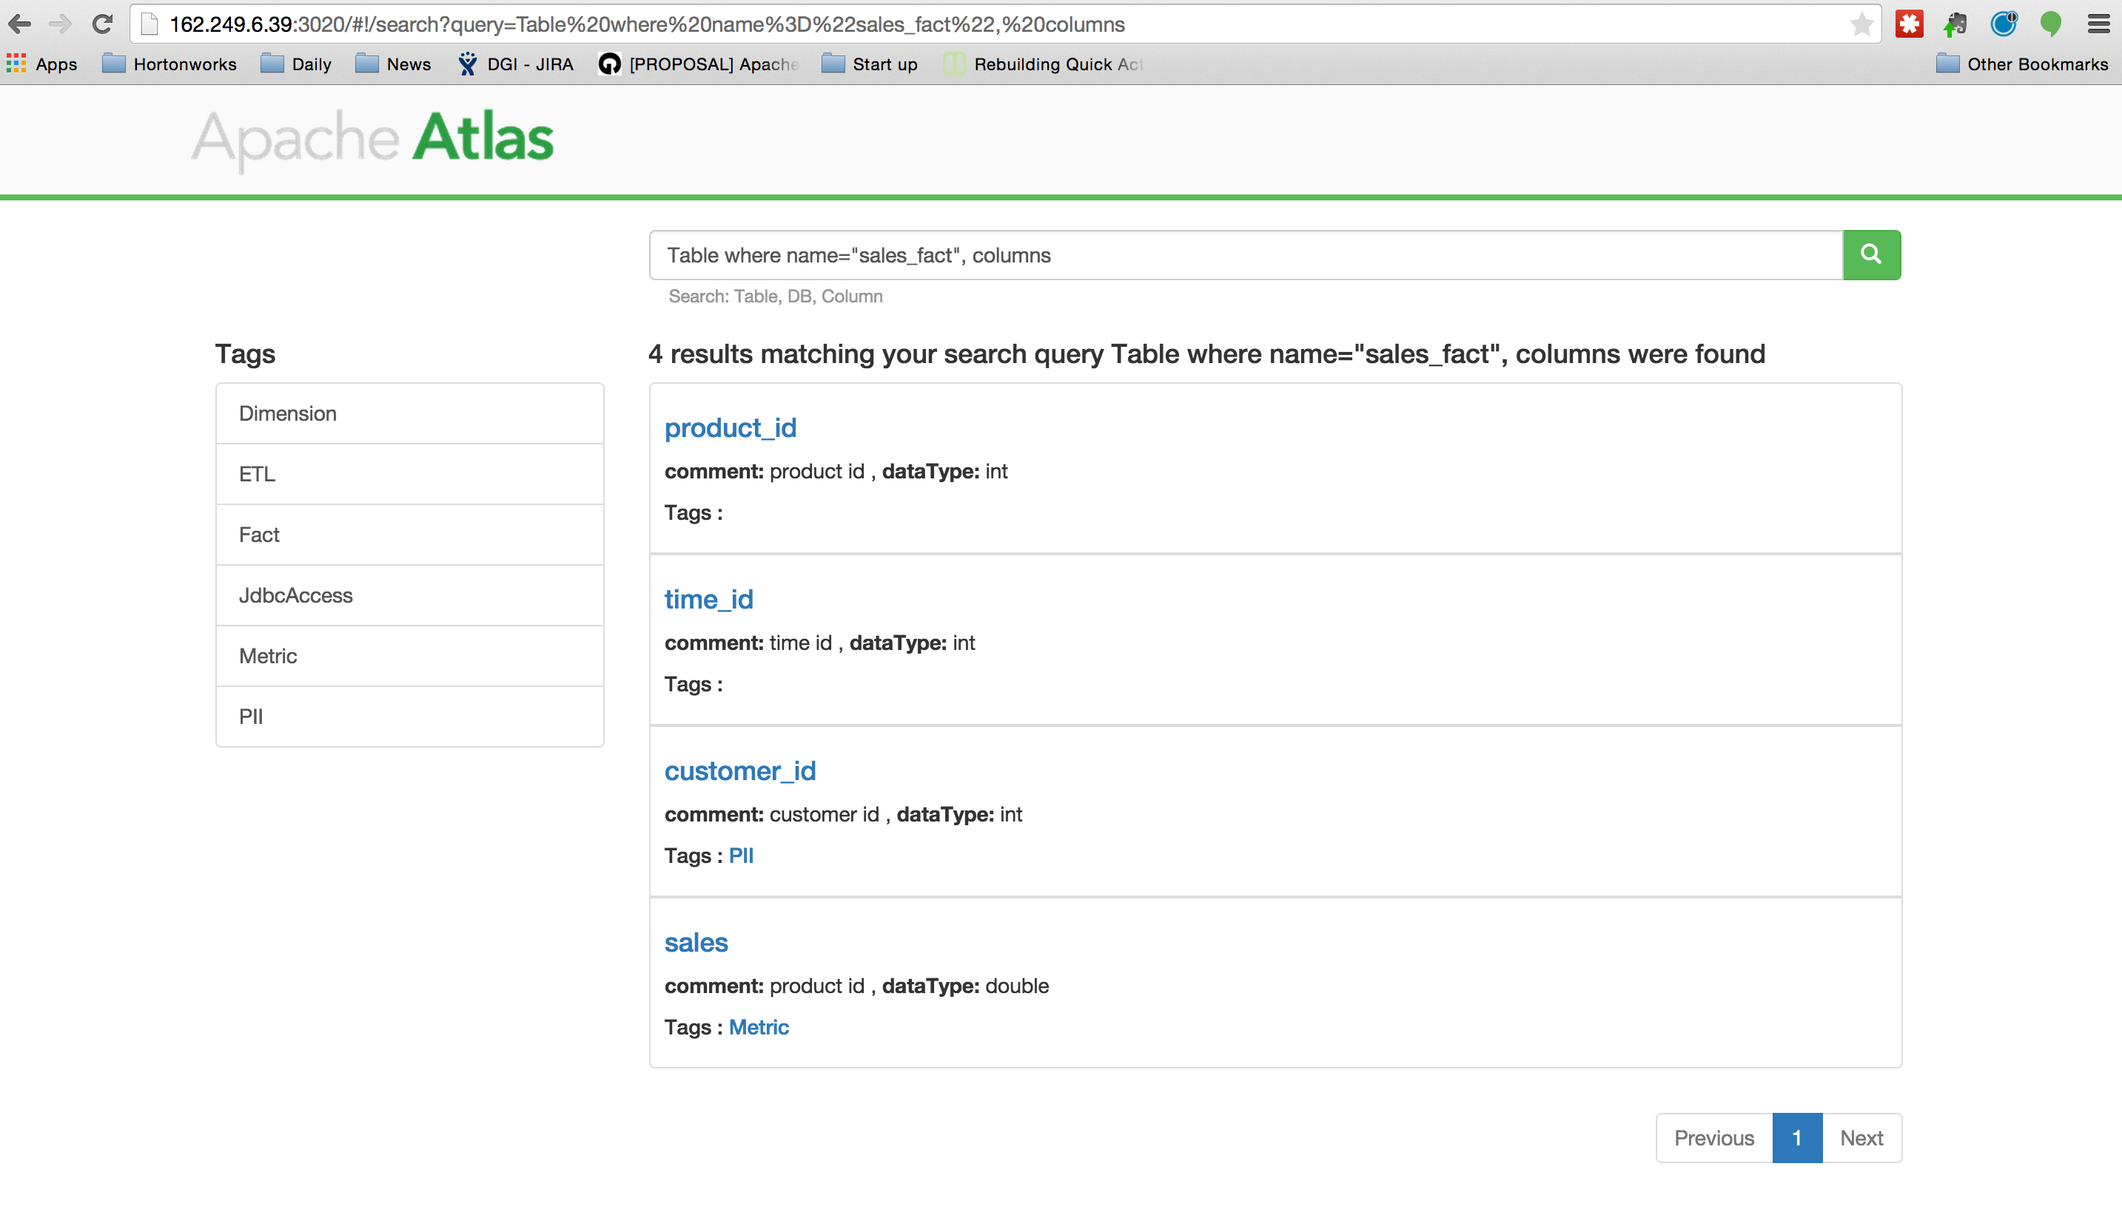

Slide 26
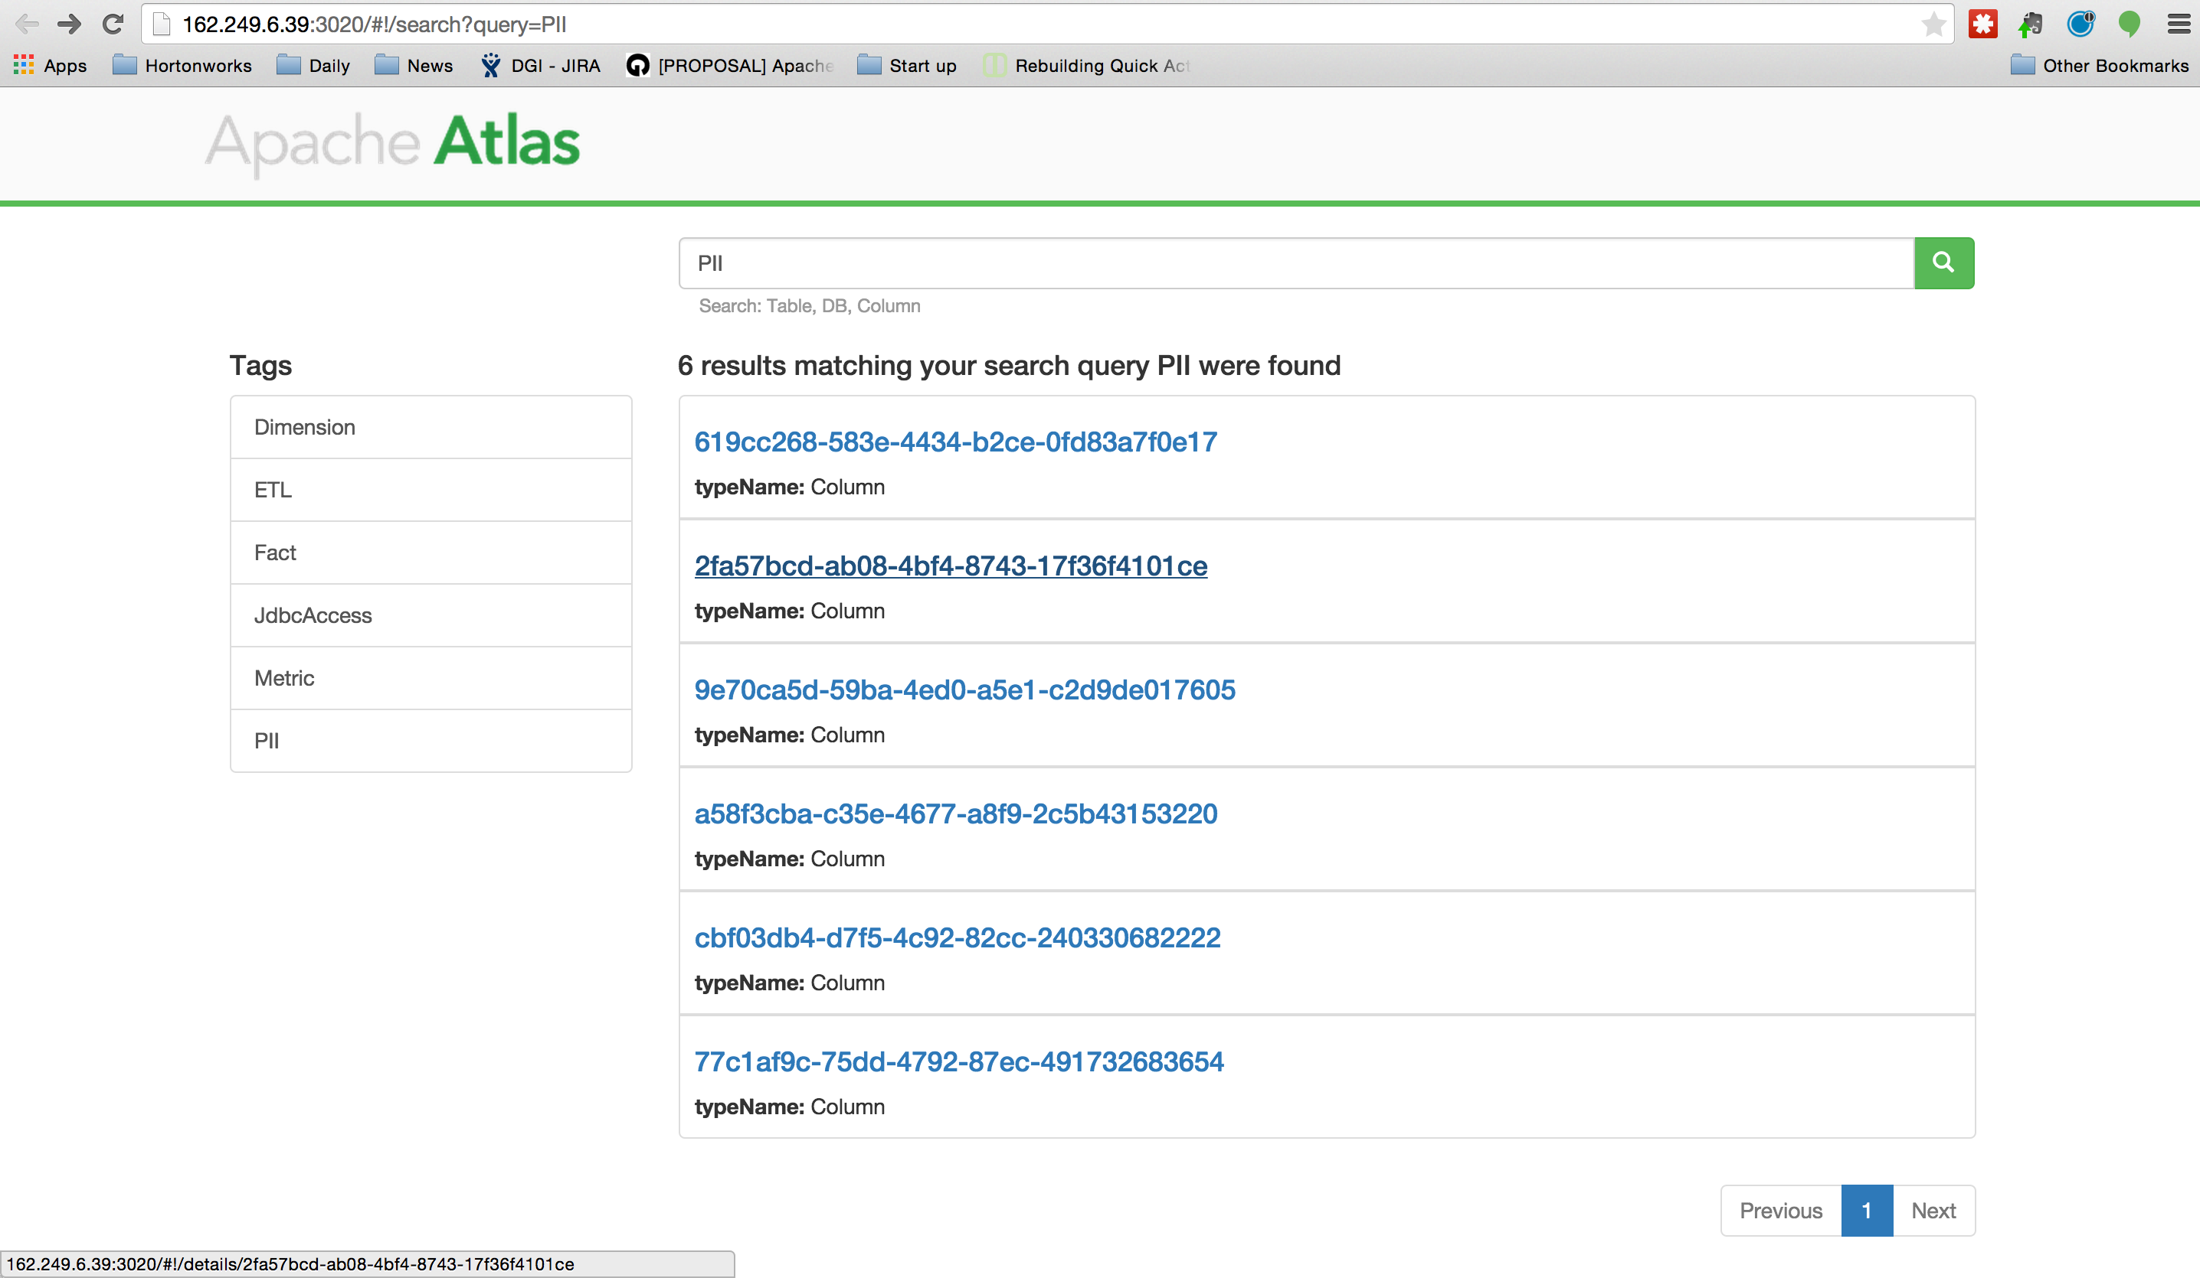

Slide 27
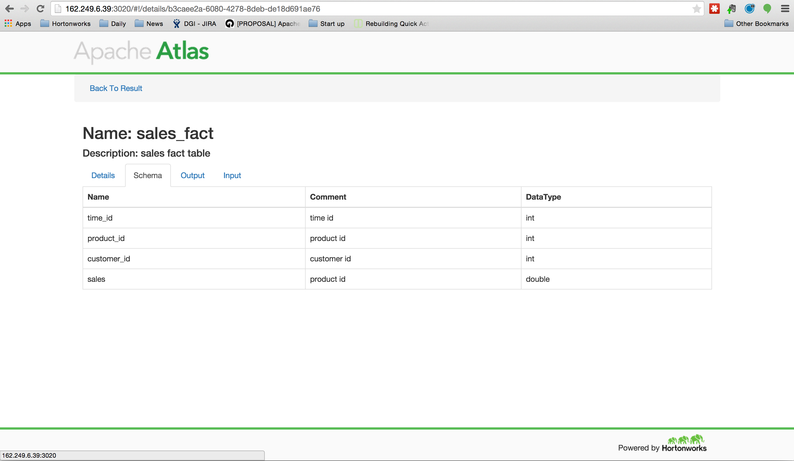

Slide 28
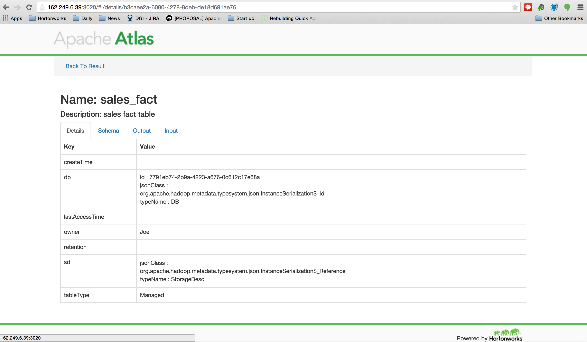

Slide 29
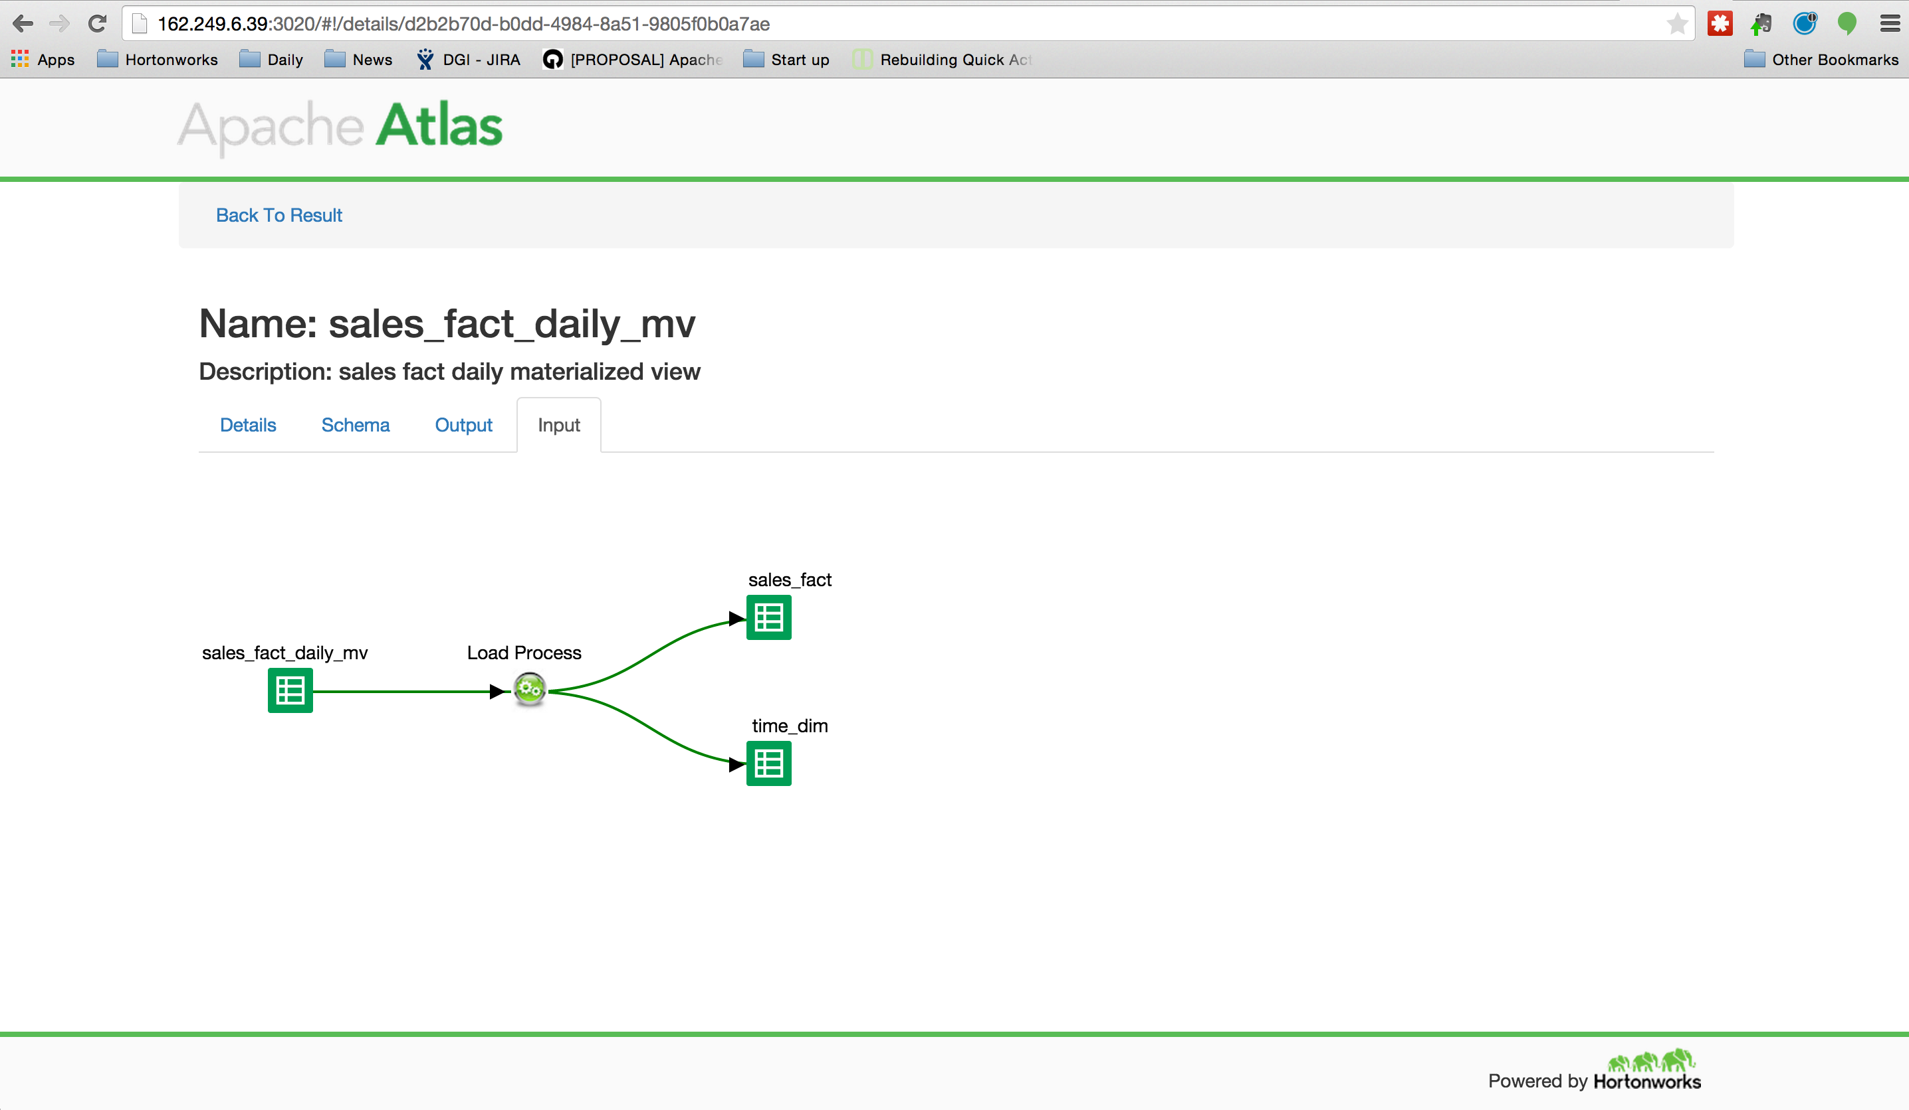

Slide 30
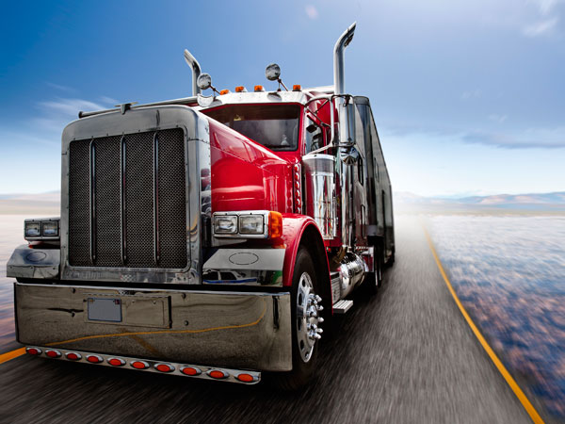
Trucking POC: Ingestion & New ETL

Slide 31

FMCSA–2004–1960: Hours of Service (Drivers)
11 Hour Driving Limit: May drive a maximum of 11 hours after 10 consecutive hours off duty…
14-Hour Limit: May not drive beyond the 14th consecutive hour after coming on duty, following 10 consecutive hours off duty…
60 / 70 Rule: Drivers many not drive more than 60 hours in 7 days or 70 hours in 8 days.
http://www.fmcsa.dot.gov/regulations/hours-service/summary-hours-service-regulations

Slide 32



Truck Driver Violations: Roles and Interests
Business Analyst: Decision support, profit impact analysis – penalties are approximately 2% of gross revenue for adjusted 5% profit for the industry. Risk potential loss of 20% of net revenue. What is our financial exposure due to violations over past month, year and 5 years? Do we need to hire drivers ?
https://www.fmcsa.dot.gov/sites/fmcsa.dot.gov/files/docs/ATTACHMENT-B_UFA-Calculations%20508%20compliant_0.pdf
http://www.forbes.com/sites/sageworks/2014/02/20/sales-profit-trends-trucking-companies/
Data Scientist: Traditional EDW analytic appliances are capacity constrained due to high cost. This workflow needs to be migrated to Hive directly from source ERP systems.
Compliance Officer: Ensure business decisions are legally defensible by following established procedures. Metadata and Lineage need to be preserved across analytic platforms.

Slide 33
POC: Solution use Apache Atlas !
ERP: Drivers
Driver Identity information
Hive: Violations
60/70 Rule violations
Hiring priority
ERP: Time Sheets:
Hours of driving time by week
Lineage in Atlas
Notes:
Show – clearly identify customer metadata. Change
Add customer classification example – Aetna – make the use case story have continuity. Use DX procedures to diagonsis
** bring meta from external systems into hadoop – keep it together

Slide 34
POC: Hours of Service (Drivers) Violation
Traditional
ERP
RDBMS
Tables:
Drivers
Timesheets
Business Taxonomy
Metadata
(JSON)
Metadata
Data
Notes:
Show – clearly identify customer metadata. Change
Add customer classification example – Aetna – make the use case story have continuity. Use DX procedures to diagonsis
** bring meta from external systems into hadoop – keep it together

Slide 35
POC: Hours of Service (Drivers) Violation
Traditional
ERP
New ETL : Hadoop
RDBMS
Sqoop_job.sh
Hive
Tables:
Drivers
Timesheets
Tables:
Drivers
Timesheets
Sqoop
Hive Hook
(Native)
Business Taxonomy
Metadata
(JSON)
Activity Reporter
(Custom)
Atlas
Metadata
Repository
Metadata
Data
Notes:
Show – clearly identify customer metadata. Change
Add customer classification example – Aetna – make the use case story have continuity. Use DX procedures to diagonsis
** bring meta from external systems into hadoop – keep it together

Slide 36
POC: Hours of Service (Drivers) Violation
Traditional
ERP
New ETL : Hadoop
RDBMS
Sqoop_job.sh
Hive
Hive
Tables:
Drivers
Timesheets
Tables:
Drivers
Timesheets
Tables:
Violations
Sqoop
ETL
Hive Hook
(Native)
Hive Hook
(Native)
Business Taxonomy
Metadata
(JSON)
Activity Reporter
(Custom)
Atlas
Metadata
Repository
Metadata
Data
Notes:
Show – clearly identify customer metadata. Change
Add customer classification example – Aetna – make the use case story have continuity. Use DX procedures to diagonsis
** bring meta from external systems into hadoop – keep it together

Slide 37
POC: Ingestion & New ETL
The objective is to show a data ingestion workflow that starts from a traditional RDBMS which lands data in Hadoop for further analysis (ETL)
Leveraging Apache Atlas, proper workflow lineage with:
Apache Sqoop pulling from Mysql
Landing in Apache Hive
ETL+ CTAS to create a new table in Hive
Lineage outside Hadoop and within:
Custom connector:
Show Lineage with Sqoop Ingestion of data
Native connector:
Hive Hook CTAS Operation
Search by data asset, or tag - DSL

Slide 38
DEMO

Slide 39
Architecture

Slide 40
High Level Architecture
REST API
Bridge
Search DSL
Hive
Storm
Sqoop
Others
Type System
Search Engine
Repository
GraphDB

Slide 41
Type System – Overview of Types
Class
Struct
Trait
Primitives
Collections
Map
Array
Instances (Entity)
Referenceable

Slide 42
Search
DSL with SQL Like Syntax
from $type is $trait where $clause select|has $attributes loop $loopExpression withPath, repeat
Examples
from DB
DB where name="Reporting" select name, owner
DB has name
DB is JdbcAccess
Column where Column isa PII
Table where name="sales_fact", columns
Table where name="sales_fact", columns as column select column.name, column.dataType, column.comment
Full-text search

Slide 43
Lineage
Uses Search DSL Loop expression
Everything results in search
Named Queries
inputs
Table where (name = \"sales_fact_monthly_mv\") as src loop (LoadProcess->outputTable inputTables) as dest select src.name as src_name, dest.name as dest_name withPath
outputs
Table where (name = \"sales_fact\") as src loop (LoadProcess->inputTables outputTables) as dest select src.name as src_name, dest.name as dest_name withPath
schema
Table where name="sales_fact", columns

Slide 44
Hive Integration
Hive Bridge
(Client)
Hive Hook
(Post-execution)
REST API
Apache Atlas

Slide 45
Key Concepts
Component Model – Parts of a HDP component. For example, Hive has DB’s, Tables and Columns.
Compliance Standards: HIPAA, PPDM, PCI, etc.
Flexible Type Systems: Types – what is it ? Traits – what is it ? Create additional slide concepts
Custom Connector – Custom reporter to Atlas using REST API
Native Connecter – Hive connector, automatically captures all SQL run against HiveServer2

Slide 46
Competitive Overview
Enterprise Readiness
July 2015

Slide 47





Competitive Summary
Topic | HDP Falcon + Atlas |  | CDH Navigator + Mgr
Life Cycle Ingest, Workflow, Eviction |  | Re-useable, metadata driven workflows with actionable output. |  | Manually identify and create policies for each dataset.
Prescriptive Lineage Workflow Tracking |  | Workflows can be tracked by BOTH logical model and audit logs. |  | Look back, low-level event reporting only. No logical model for validation
Audit Activity Tracking |  | Security logs and Atlas event positively correlated by metadata. |  | Forensic approach based on time algorithm, not air-tight.
Metadata Services Type System, Tagging, Taxonomy |  | Open extensible type system, True hierarchical taxonomy and inheritance. |  | Proprietary, basic query-able store. Flat tagging: name -value pairs.
3rd Party Support Interoperability with Hadoop Eco-system |  | Gov Ready Certification program ensures partner integration and collaboration |  | Discrete vendor integration – silo’d approach with no sharing of metadata or lineage visibility.
Notes:
Cloudera Navigator attempts to assemble the audit and lineage picture based on a algorithm from individual events. This approach will not stand audit test because you can never prove with 100% certainty that you have all the discrete events (forensic approach).
Can competive column –
+ add to Raf addition to Infra+CDH

Slide 48
FAQ’s

Slide 49
Atlas versus Falcon: What’s the difference?
Atlas core strength is Metadata
Collecting metadata and reporting it back.
Technical or business classification
Hierarchical with inheritance of attributes (PII)
Falcon core strength is data Life Cycle
Data movement management
Re-useable job definitions
Instance level (log) Lineage and Audit

Slide 50
When to use Atlas versus Falcon?
Atlas core strength is Metadata
Business Classification
Integration with other components or tools
Falcon core strength is data Life Cycle
Orchestrate workflow for Oozie
Manage and track repeating jobs
Audit for pipelines

Slide 51
FAQ’s
Lineage : What is the difference b/t Falcon and Atlas ? Falcon is only for falcon entities. Atlas can trace for any component. Falcon tracks instance of its entity. Atlas does not track instance – integration with Log Search effort.
Tag vs Label: Falcon has free from labels. Tags (traits) in Atlas are ordered into a hierarchy with inheritance
Search DSL: Domain Specific Language. Atlas has SQL like query language.
More selected from Governance Field Poll :
https://drive.google.com/a/hortonworks.com/folderview?id=0B67w627CdwANNkYxRUdkNEx3Nms&usp=sharing

Slide 52
Atlas Resources
HDP 2.3 Preview Sandbox VM:
http://hortonworks.com/hdp/whats-new/
Apache Atlas:
http://atlas.incubator.apache.org/
http://incubator.apache.org/projects/atlas.html
https://git-wip-us.apache.org/repos/asf/incubator-atlas.git
Apache Falcon:
http://hortonworks.com/hadoop/falcon/
http://hortonworks.com/wp-content/uploads/2015/06/Falcon-UI-Preview-Instructions.v2.pdf
Partner Workshops
http://hortonworks.com/partners/learn/
More to come with official GA release of HDP 2.3

Slide 53
Thank you !

